Slide 1
SCHEDULING OF MARKETING EXECUTIVE
-by
ABHIJITH D.A. 1PI01IS001
DEEPAK V. 1PI01IS022
MAHESH M.P. 1PI01IS042
Guide:
Dr. M. Mathirajan (IISc)
Mr. S.P. Srikanth (PESIT)

Slide 2
Introduction
PERSONAL SCHEDULING
Allocating people (personnel) to time slots and possibly locations.
Examples of Personal Scheduling.
Nurse Scheduling.
Political Campaign.
Mobile Courts.
Traveling Sales Man Problem.
Scheduling of Marketing Executive (SME).

Slide 3
Literature Survey
For the first time SME (Scheduling of Marketing Executive) has been solved using Mathematical Model by Dr. M. Mathirajan.
But using Mathematical model, it takes lot of time, hence we go for Heuristics approach.
Company Holidays, Head Office visits and General Holidays were addressed. We have also addressed Customers Weekly Off.
Our Project is a Prototype DSS.

Slide 4
SME . . . ?
Situation:
A City is divided in to Regions {R1, R2, … Rn};
Region => {Different Types of Customers}
(Types = Based on Business Interaction with the Company.)
Different Customer => Different No. of Visits.
A particular ME is assigned one Region.
Objective:
Schedule ME with in a given Period.
Constraints:
No. of Visits over a period for each customer.
No. of Visits per day {Maximum, Minimum}.
Maintain the appropriate interval b/w each customer visits.

Slide 5
ABC Analysis
Cross-Application components:
Classify according to Specific measures.
Each object is considered one of the following.
  A – Important.
  B – Less Important.
  C – Relatively unimportant.
An Object can be a material, a vendor, or a plant.

Slide 6
Things to be Considered.
Scheduling Period, SP = {Start Date, End Date}
Holidays, H = {Head Office Visit, Customer Closure day, General Holiday, Company holiday}
Visits, V = {Different for Different Types of customer, but same with in each type}
Effective Working Period, EWP = {Schedule period – Holidays}
(Here while calculating EWP for customers, only customer closure days and General Holidays are considered in Holiday set.)
Intervals = (EWP of C_{i}) / (V of C_{i}) {C_{i} => Customer i}

Slide 7
ASSUMPTIONS
No limit in movement of ME.
Time & Travel Cost not considered.
Same work hours for ME & customer.
Customer emergency not addressed.
No policy change during planning period.
Natural calamities unaccounted.
Sequencing of customers not specified.
If HO visit = General Holiday , no need for ME visit.

Slide 8
Project Requirements
A Company.
A Marketing Executive.
A set of Customers.
Time Period.

Slide 9
SOLUTION METHODOLOGY
Two Types
  MATHEMATICAL MODEL (Goal Programming)
  HEURISTIC APPROACH

Slide 10
MATHEMATICAL MODEL:
(0,1) Goal Programming
Mathematical formulas should be employed.
Advantages
Gives Best Solution.
Difficulties
Computational Complexity.
Time Consuming. (Output: 5-6 days, when tested on LINDO Software)
Difficulty in modifying result.
Analyzing formulas is difficult.

Slide 11
HEURISTIC APPROACH (HA)
Advantages
Very Fast (with in few minutes).
Allow managers to modify the result.
Any Common approach can be used.
Disadvantages
Doesn’t guarantee best solution always.

Slide 12
Heuristics For SME
Six types employed:
Systematic HA.
First Day First Customer HA. (FDFC)
Last Day First Customer HA. (LDFC)
Random Days HA.
Random Customers HA.
Complete Random HA.

Slide 13
PRESCHEDULING ACTIVITY
Accept:
Scheduling period
Holidays {Head Office Visit, Customer Closure day, General Holiday, Company holiday}
Types & Number of customers
No. of Visits for each Type.

Slide 14
Systematic Heuristics
Perform Pre-scheduling activity.
Effective Working Days computed.
Compute Time Interval between visits.
Assign ME to visit first customer on first effective working day, and so on.
Maintain the constraints.

Slide 15
First Day First Customer
Similar to Systematic Approach.
Greedy strategy followed while assigning ME to visit customers.
Last Day First Customer
Similar to FDFC Approach.
But scheduling starts from last effective working day and proceeds to the first.

Slide 16
Random Days Heuristics
Similar to Systematic HA.
But start scheduling with random day instead of starting from first feasible working day.
Random Customers Heuristics
Scheduling similar to Systematic HA.
But, here Customer of a particular type is chosen randomly.

Slide 17
Complete Random Heuristics
It is a combination of both Random Customers and Random Days HA. i.e. both customers and days are chosen random.

Slide 18
Decision Support System (DSS)
A DSS assists managers in their decision making specifically in semi structured and unstructured problem situations.
A DSS supports and enhances, rather than replace, managerial judgments.
A DSS improves the effectiveness of the decision rather than its efficiency.
4. A DSS supports the personal decision making styles of individual managers.

Slide 19
COMPONENTS in DSS
3 components.
DMM (Data Management Model).
UI/CMM (User Interface/Component Management Model).
MMM (Model Management Model).

Slide 20
A PROTOTYPE DSS FOR SME
DMM:
Customer holidays , ME holidays , Penalty
Files.
MMM:
6 Heuristics employed.
CM/UIM:
Interface used for accepting inputs and displaying the result.

Slide 21
DATA MANAGEMENT MODULE
Customer Holiday entries
  (0,0) (1,4) (2,0) (3,3) (4,2) ………
ME holidays file Entries
  0 3 5 7 15
Penalty file entries
  25 5 1

Slide 22
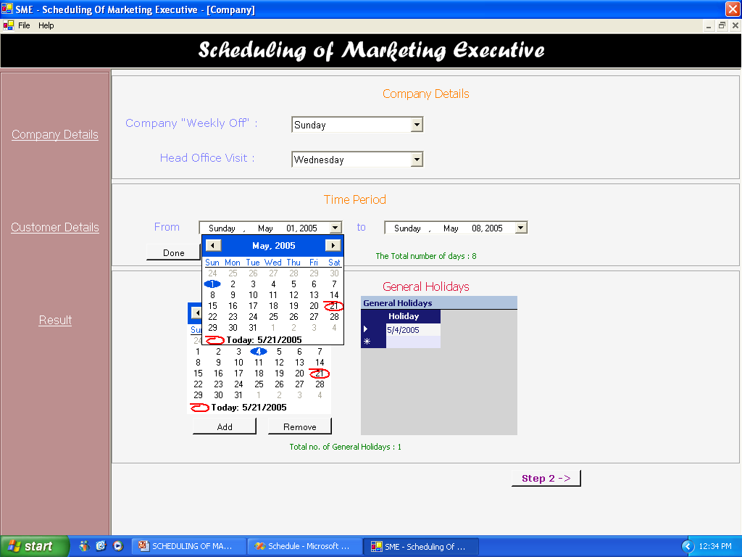
USER INTERFACE (Inputs)

Slide 23
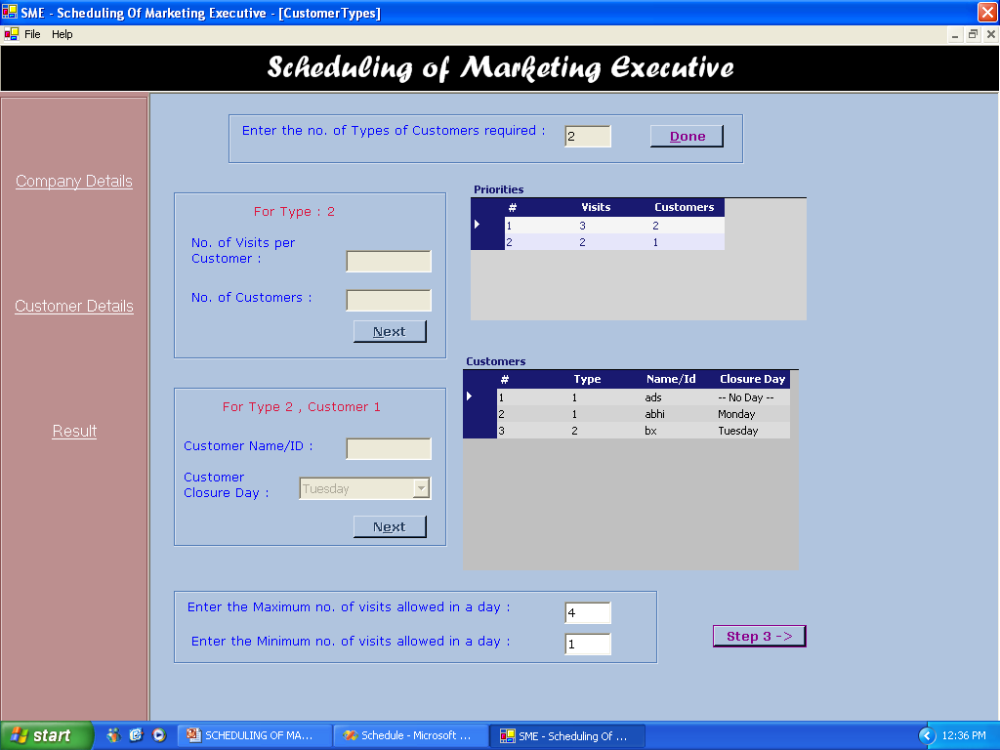
USER INTERFACE (Inputs)

Slide 24
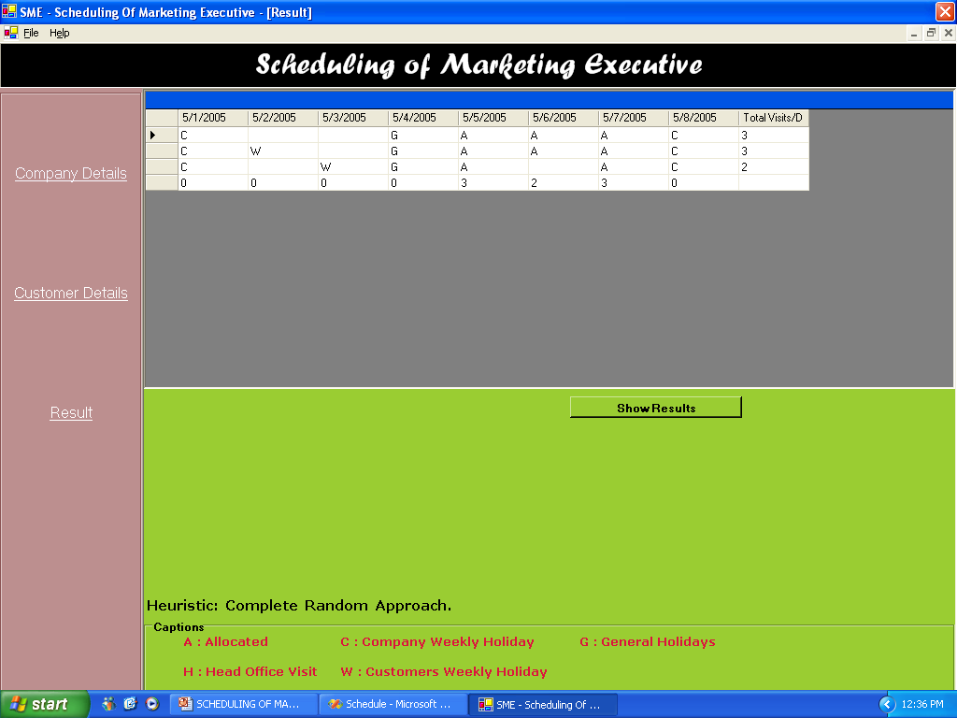
USER INTERFACE (Result)

Slide 25
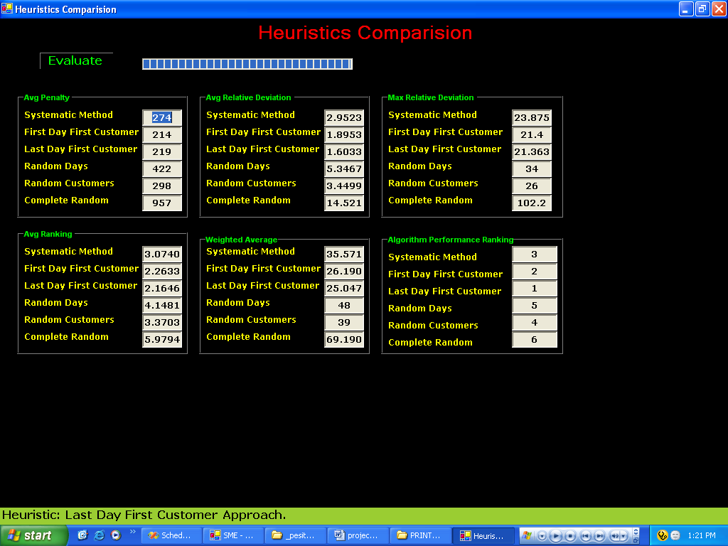
USER INTERFACE
(Comparisons)

Slide 26
Testing
Code Testing
  Logics of the statements are ensured.
Program Testing
  Every Algorithm, has been done individually and verified for the results.
System Testing
  After integrating all the modules, the system is tested for its working.

Slide 27
Testing (contd…)
User-factor Testing
  The user interface has been ensured for many errors to be caught.
To give the best quality of results, we have used Performance measures to compare b/w different Heuristics.

Slide 28
Quality of Heuristic Solution
Computational Experiments
Generic Test data generation
2) Performance Measures

Slide 29
Parameters No. of Levels Values
Planning Period 01 One Month
Customers type 01 03
Total Customers 01 21
NA 03 2,3,4
NB 03 8,9,10
NC Derived ----
A type visits 03 9,8,7
B type visits 03 7,6,5
C type visits 03 3,4,5
Max Visits 01 08
Min Visits 01 04

Slide 30
31 21 3 2 8 11 7 5 3 8 4
31 21 3 2 8 11 7 5 4 8 4
31 21 3 2 8 11 7 5 5 8 4
Sample Test Data
The number of Test Data that can be
derived with this setup is about
3*3*3*3*3 = 243.
All these test data goes as input in testing the algorithm for its consistency.

Slide 31
PERFORMANCE MEASURES
Relative Percentage Deviation :
(H_{soln} - Best H_{soln}) / Best H_{soln} =
( 271 –182)/182 FOR PI1 (HA1)
PI HA1 HA2 HA3 HA4 HA5 HA6
PI1 271 263 351 427 182 638
PI2 355 107 181 268 203 922

Slide 32
PERFORMANCE MEASURES
Average Relative Percentage Deviation
Maximum Relative Percentage Deviation
PI HA1 HA2 HA3 HA4 HA5 HA6
PI1 0.48 0.44 0.92 1.34 0 2.50
PI2 2.31 0 0.69 1.50 0.89 7.61

Slide 33
PERFORMANCE MEASURES
Penalty values for Instances - Avg penalty
PI HA1 HA2 HA3 HA4 HA5 HA6
PI1 271 263 351 427 182 638
PI2 355 107 181 268 203 922
Ranking of Algorithms
PI HA1 HA2 HA3 HA4 HA5 HA6
PI0 3 2 4 5 1 6
PI1 5 1 2 4 3 6

Slide 34
PERFORMANCE MEASURES
Algo HA1 HA2 HA3 HA4 HA5 HA6
Avg 2.9 2.18 2.12 4.59 3.2 5.9
Ranking
Weighted Average
Take Largest value as the best, while measuring performance.

Slide 35
Conclusions
Even though Mathematical model gives a good solution, for managers, who need to decide with in few minutes, Heuristics is relatively good.
The main draw back (Time) of Mathematical model has been overcome.
Having many Heuristics, still comparing them relatively takes less time, and also ensures good solution.

Slide 36
Future Enhancements
The current prototype DSS can be made a complete DSS, by allowing managers to change the results.
Using database, it can be made possible to have large no. of customers over a long period.
Reports can be generated based on the Customer, Marketing Executive or Company requirements.
Simulation Feature can be incorporated to do “What If Analysis”.

Slide 37
BIBLIOGRAPHY
A (0-1) Goal programming approach for scheduling the tour of a marketing executive, Dr. M. Mathirajan and R. Ramanathan, IISC, Bangalore and Sultan Qaboos University, Oman.
http://help.sap.com (ABC Analysis).
ilog.com (Nurse Scheduling)
dotnetSpider.com (for C# & .NET)

Slide 38
T H A N K Y O U
Everyone’s life will become cosy, when they have a proper schedule for doing things.

